Slide 1


IBM Attrition Study Team 4 Ben Dieck , Justin Richardson, Erik Newcome
Insert photo credit (https://www.lohud.com/story/news/2014/07/10/ibm-chip-research-westchester-county-jobs/12489415/)
Notes:
Justin

Slide 2

Scope of Presentaion
Data Overview
Project Details
Business Analysis
Turn over analysis of junior employees
Attributes of Employees that Stay
The Ones that Leave
Compensation and Retention
Other Modeling
Further Study
Notes:
Justin or Ben

Slide 3
Project Details
The IBM HR Dataset
The dataset being utilized for this project is an experimental dataset that was developed by IBM in order to coach a machine learning algorithm in an example case to predict the occurrence of employee turnover. The original IBM posting credits Kaggle as the data source of the set. IBM posted a link to a GitHub entry for the data source used to generate the notebooks used for coaching their machine learning tool. No original author was found for the dataset. An internal search of both Kaggle and Github returned multiple copies of the same dataset with no version history or author. What is clear is that there is correlated information within the dataset that was utilized to coach a machine learning tool. That suggests the data set will serve the purposes of our project well.
The IBM HR data set consists of 1470 observations of 35 variables. It is information that provides both categorical and quantitative variables that are associated with organizational retention. The focus of the project will be to predict the factors that cause employee turnover in the interest of employee retention.
The target audience includes corporate executives, managers, and HR professionals. Throughout all industries and disciplines it has been proven that it is more cost effective, and productive, to retain previous employees than to recruit, hire, and train new talent to fill gaps.
Notes:
Justin or Ben

Slide 4
Project Details
Scope of Work: Questions and Insight
The study of this dataset was done utilizing a mixture of descriptive and visual data analytics, linear regression, and associative rules datamining. Initial insights were gleaned with analytics and allowed the set to be munged and subsetted which allowed for more impactful modeling. It also displayed some trends that became important to the longevity of business:
1.Is there higher turnover amongst junior employees(2 years or less) vs. senior employee (2+ years) and why might this be?
2.What type of employee will stay with the company over time? What do they look like, what attributes do they have?
3. What type of employee is most likely to leave the company? What do they look like, what attributes do they have?
4.What is the relationship between compensation, and retention? In a regression study, and predictive analysis, what would be the
R2value of total compensation in explaining attrition behavior?
5.Is there a correlation between salary, gender, age, education, years with the company?
Notes:
Justin or Ben

Slide 5
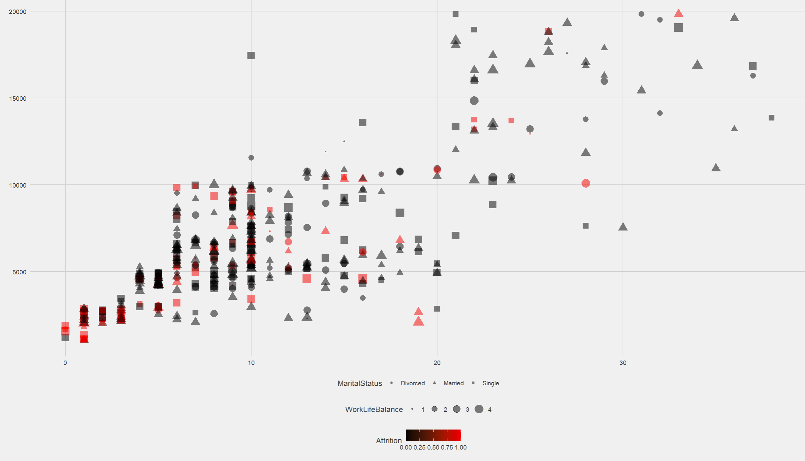

1.Is there higher turnover amongst junior employees(2 years or less) vs. senior employee (2+ years) and why might this be?
Yes, there is a higher turnover amongst junior employees over senior ones. The junior employees that are leaving are overwhelmingly single, have less than 6 years working experience and have been with IBM for less than 3 years.
Other factors: training time in the past year, maintaining a high education but occupy a entry level position and seeks newer job opportunities. This could represent a mismatch of hiring priorities. These junior employees are potentially leveraging the IBM name and reputation to further their career in the short term.
This scatter plot shows high saturation of individuals leaving in early years of employment, single people, and with high work / life balance.
Notes:
Ben

Slide 6
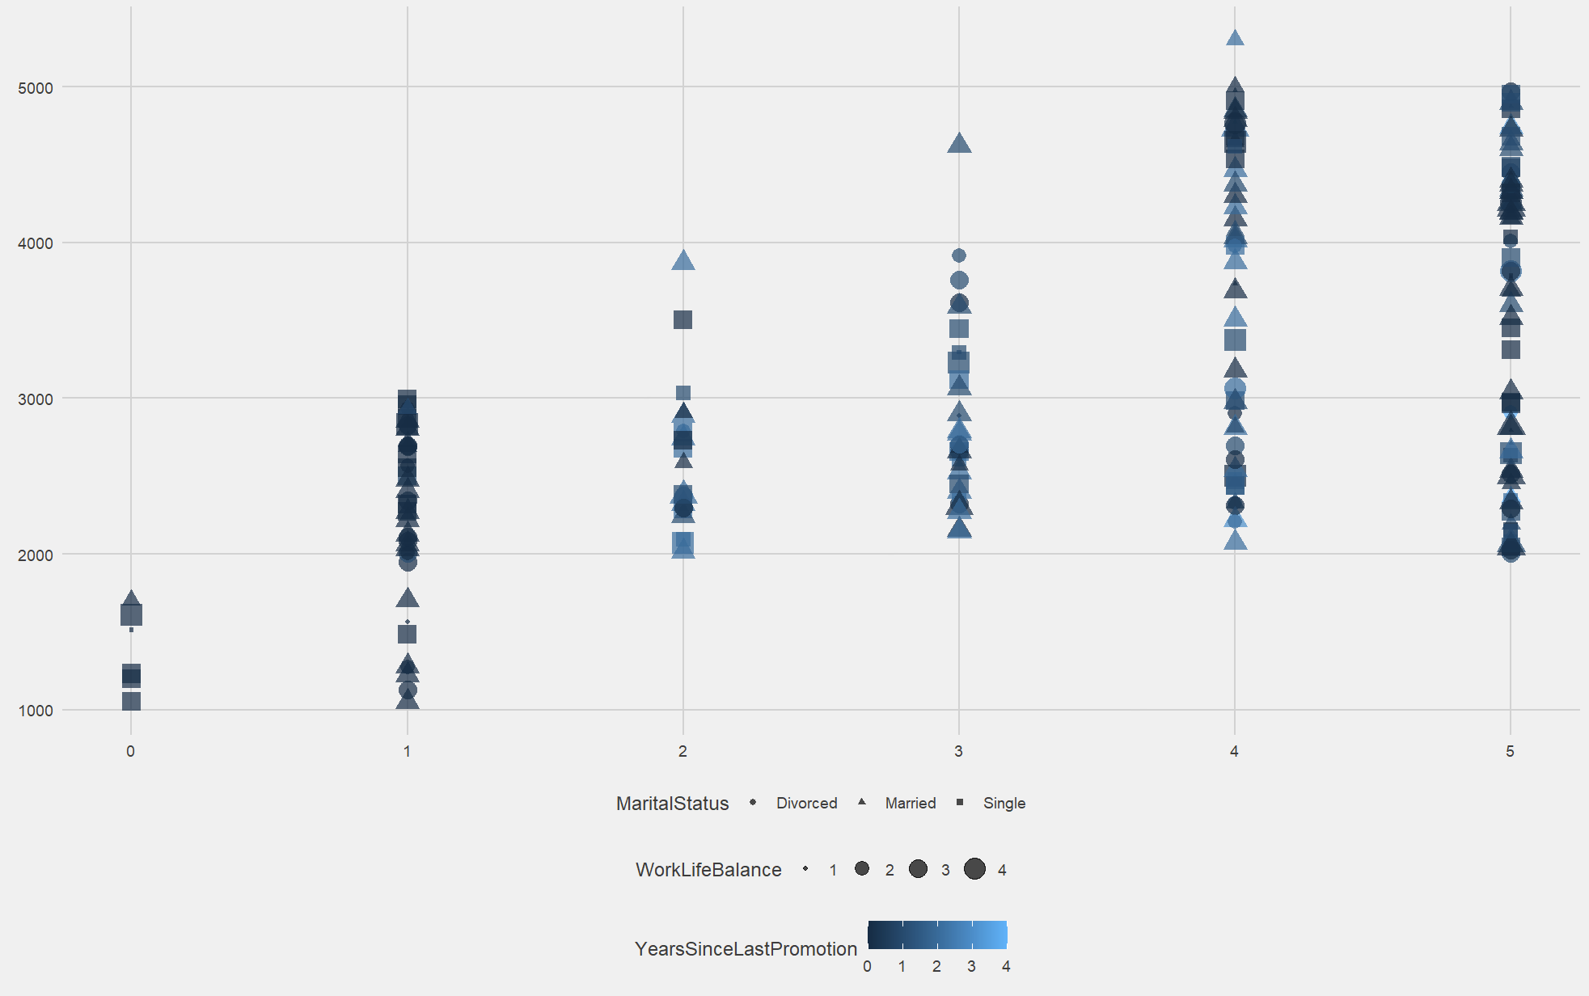
1.Is there higher turnover amongst junior employees(2 years or less) vs. senior employee (2+ years) and why might this be?
Individuals within their first 6 years that are staying report a high work life balance, trend towards not being single, and receiving a promotion within the past 2 years.
This is suggestive that marital status within this category is a non-factor, while upward mobility, and career potential within the company has high importance for retention. Especially as we look at year five where the ones that stay have a 0-1 year of promotion to have retention.
Notes:
Ben

Slide 7
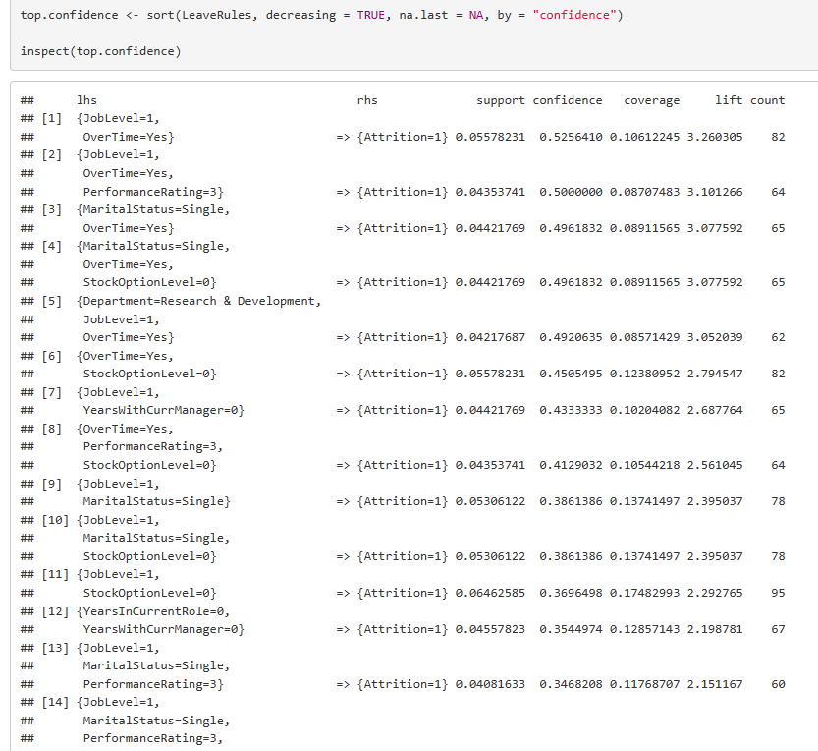
What type of employee will stay or leave the company over time?
Different models were attempted in order to predict attrition.
The most accurate was attained through Associative Rules Datamining.
The most accurate rules assembled traits that give insights to who will stay or leave the company based on statistical qualities.
Notes:
Erik Discusses Attributes, Ben talks about associative rule mining,

Slide 8
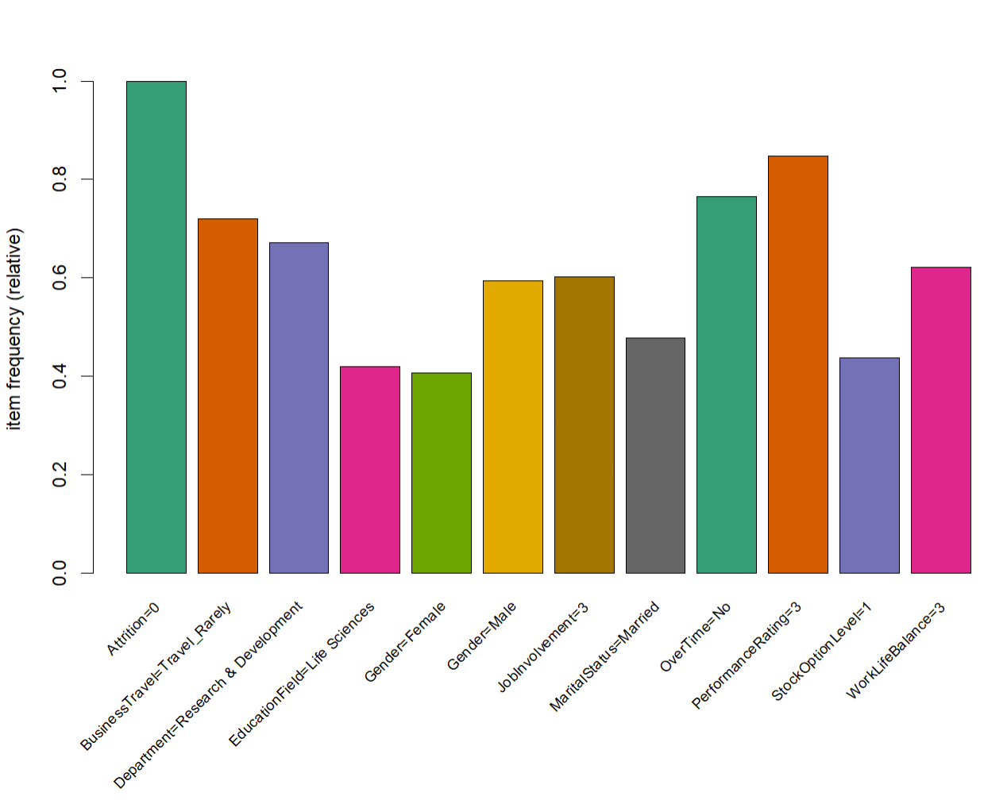
2.What type of employee will stay with the company over time? What do they look like, what attributes do they have?
Using Associative Rule Mining concepts, the typecast employee who will stay :
^{Rarely travels for business,}
Has a Life Science degree from college, maintains an Employee Engagement Score of at least 75%,
^{Is married,}
^{Does not work overtime,}
Maintains a performance rating of at least 3 out of 4 and is
Part of the Stock option level 1.
Interestingly, salary is not a factor in whether you stay or leave; more detail on this in Question 4.

Slide 9
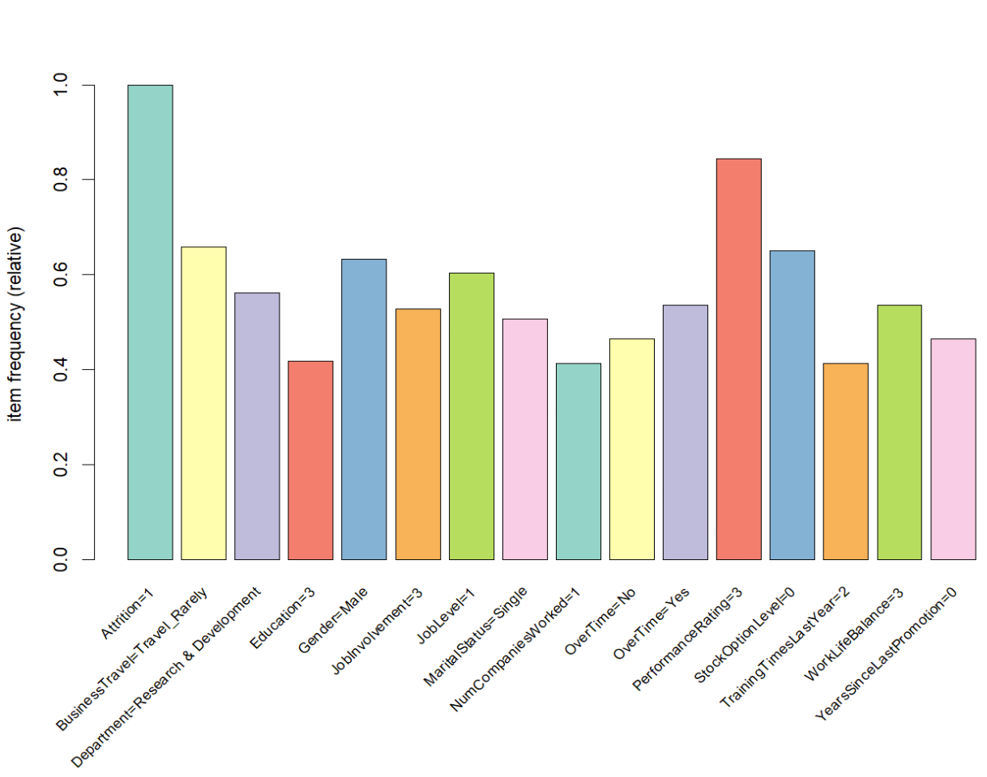
3. What type of employee is most likely to leave the company? What do they look like, what attributes do they have?
The employees that are most likely to leave:
Make less than $6,000 per month indicating that salary could be a contributing factor for leaving the company, but the decision will involve more factors.
Our analysis shows that the individuals that leave are commonly have the following traits: young, single males, rarely travel, and have not been with the company long.

Slide 10
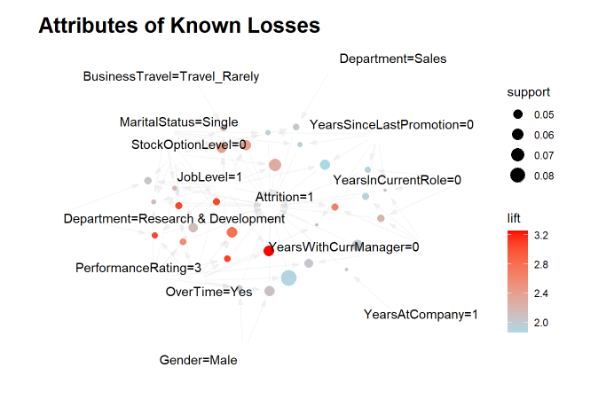
3. What type of employee is most likely to leave the company? What do they look like, what attributes do they have?
The attributes associated with attrition for known losses here are shown based on results using associative rules mining. The greatest relationships between losses and attrition are:
^{Years since last promotion}
^{Job Level 1 (Entry Level)}
^{Does Not have a stock option}
Years with the current manager: also reflects new in role, and new in company.
Is single and has maneuverability outside of the company.
Males seem more likely to leave than females.

Slide 11
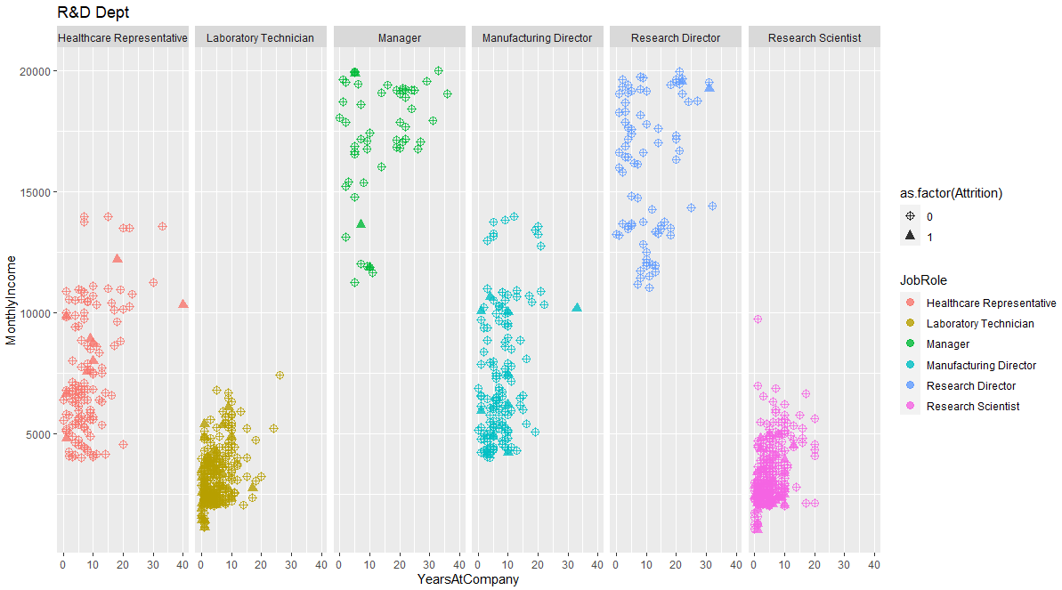
4.What is the relationship between compensation, and retention? In a regression study, and predictive analysis, what would be the R2value of total compensation in explaining attrition behavior?
Research &Development Department
No correlation between an employee’s retention and compensation (monthly salary) could be found.
HR Reps, Lab Techs, Research Scientists and Sales Reps they cap out at less than $5k per month and less than 10 years with the company.
Healthcare Reps, Manufacturing Directors and Sales Execs they thin out at $7500 per month and have been with the company less than 15 years.
Managers and Research Directors have a monthly Salary cap at $20k per month with a mean of around $17,500. They generally have been with the company longer.

Slide 12
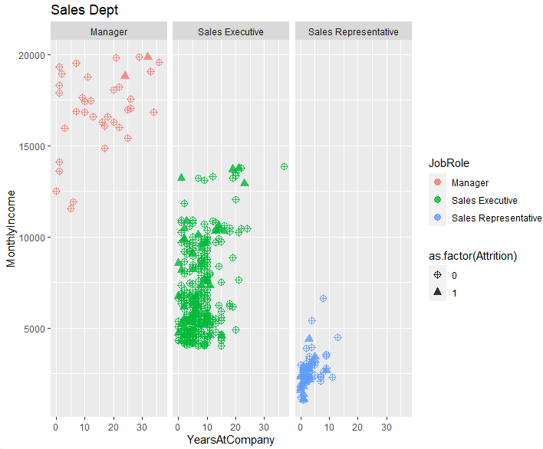
4.What is the relationship between compensation, and retention? In a regression study, and predictive analysis, what would be the R2value of total compensation in explaining attrition behavior?
Sales Department
Sales Representatives and Sales Executives both have a clear retention point of 10 years. Sales managers show an even distribution of retention across the scatter plot that represents them.
Managers – There is no clear relationship between time with the company and compensation.
Sales Executives – Shows a retention point of 10 years and $10k per month. After that their attention is less dense showing most people leave after 10 years.
Sales Representative – This group shows an average max retention of 5 years and an average monthly income cap of $3,250.

Slide 13
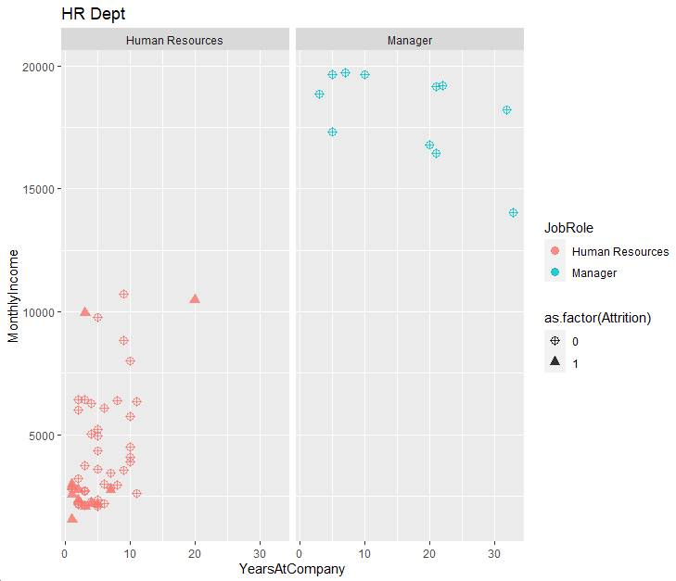
4.What is the relationship between compensation, and retention? In a regression study, and predictive analysis, what would be the R2value of total compensation in explaining attrition behavior?
^{Human Resources Department}
The Human Resources department has a very different relationship between time at IBM, the individual monthly income, and attrition for the two positions in that department.
Human Resources (HR) – The human resource represented here that leave are employees that leave within five years and do not make more than $2,500 per month. If they clear both attrition points it shows they are likely to make it to the 10 year mark and not any further.
HR Managers – Managers show little to no correlation between compensation and retention. On the scatter plot they are shown as evenly distributed from 0 to 40 years at IBM. They do show that the average HR manager between $17,500 - $20,000 per month.

Slide 14
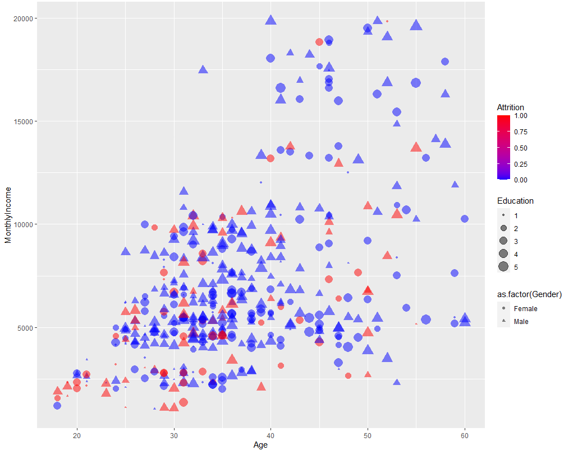
5.Is there a correlation between salary, gender, age, education, years with the company?
The analysis was clear that gender and age did not contribute to an employee’s salary. Total years with the company was a good indication of a positive incline in salary. Employees who held high level degrees tended to leave the company quickly.
The highest rate of attrition remains in the bottom left quadrant of this visualization with younger lower earners trying to find better opportunities. This plot was isolated to one department, but overall metrics remain the same .
Notes:
Ben

Slide 15
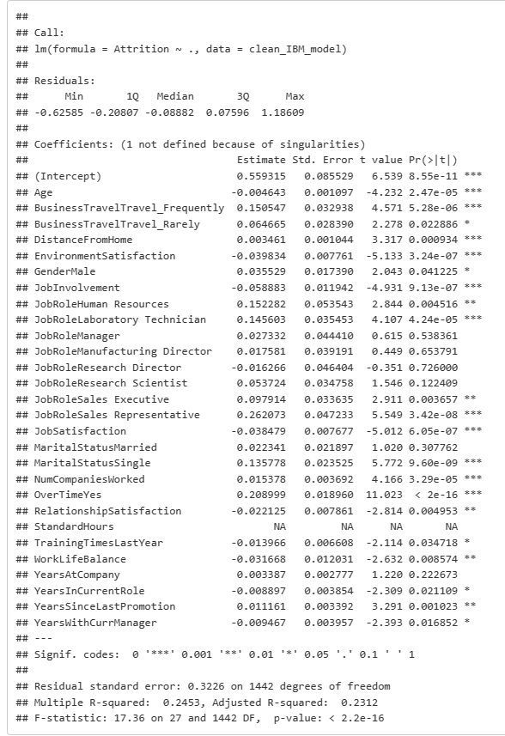
Linear Regression Analysis
Within the linear regression modeling of attrition ~all significant variables we find that the model does not allow us to predict enough of a value for Attrition for us to make confident predictions.
It is better to use the Associative rules model until a better linear model can be developed.
Notes:
Ben

